Slide 1
The Legend of the Three Sisters
IQhub Lesson
adapted from Food Corps

Slide 2
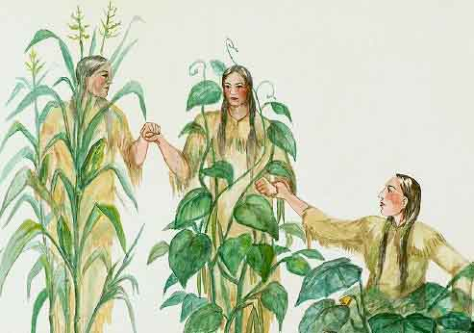
Once upon a time very long ago, there were three sisters who lived together in a field.
These sisters were quite different from one another in their size & also in their way of dressing.

Slide 3
One of the three was a little sister, so young that she could only crawl at first, & she was dressed in green.

Slide 4
The second of the three wore a frock of bright yellow, and she had a way of running off by herself when the sun shone and the soft wind blew in her face.

Slide 5
The third was the eldest sister, standing always very straight and tall above the other sisters and trying to guard them. She wore a pale green shawl, and she had long, yellow hair that tossed about her head in the breezes.

Slide 6
There was only one way in which all three sisters were alike. They loved one another very dearly, and they were never separated. They were sure that they would not be able to live apart.

Slide 7
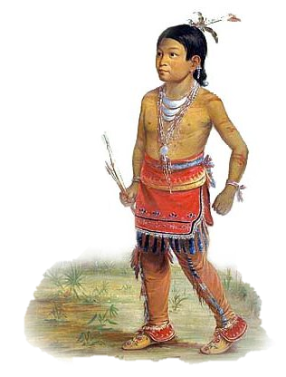
After awhile a stranger came to the field of the three sisters, a little Indian boy. He was straight as an arrow and as fearless as the eagle that circle the sky above his head. He knew the way of talking to the birds and the small brothers of the earth, the shrew, the chipmunk, and the young foxes.

Slide 8
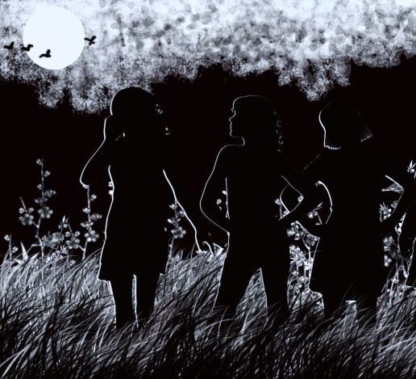
And the three sisters were very interested in the little Indian boy. They watched him fit his arrow in his bow, saw him carve a bowl with his stone
knife, & wondered where he went at night.

Slide 9
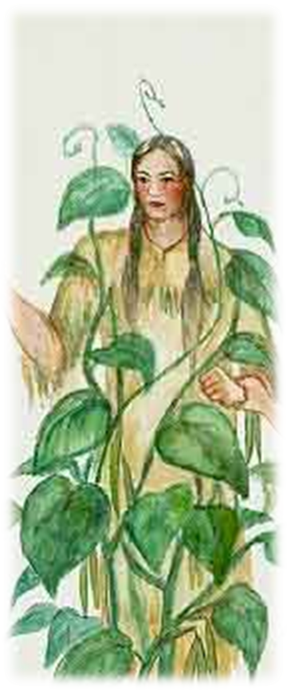
Late in the summer of the first coming of the Indian boy, one of the three sisters disappeared. This was the youngest sister in green, the sister who could only creep. She was scarcely able to stand alone in the field unless she had a stick to which she clung. Her sisters mourned for her until the fall, but she did not return.

Slide 10
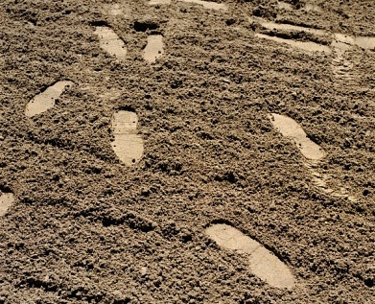
Once more the Indian boy came to the field of the three sisters. He came to gather reeds at the edge of a stream nearby to make arrow shafts.
The two sisters who were left watched him & gazed with wonder at the prints of his moccasins in the earth that marked his trail.

Slide 11
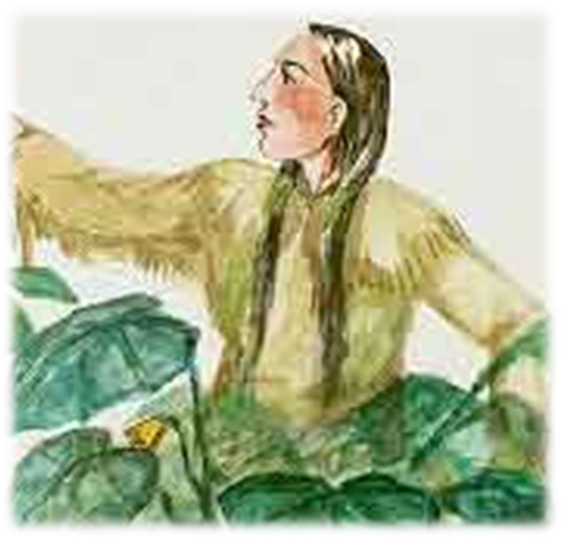
That night the second of the sisters left, the one who was dressed in yellow and who always wanted to run away. She left no mark of her going, but it may have been that she set her feet in the moccasin tracks of the little Indian boy.

Slide 12
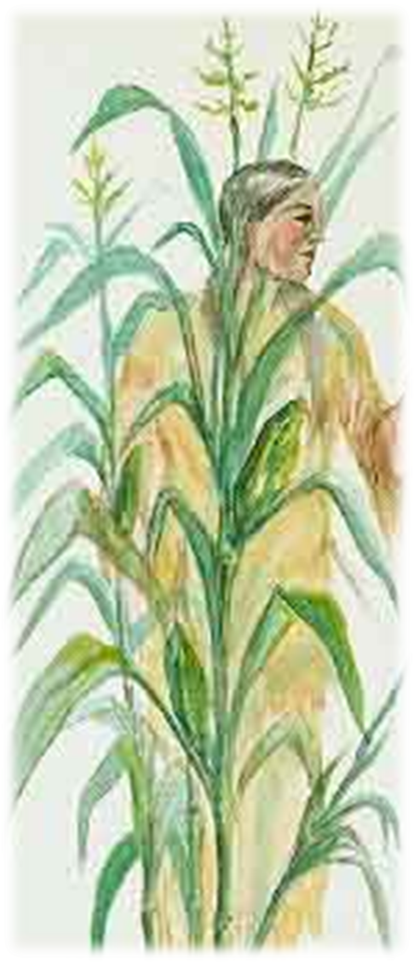
Now there was but one of the sisters left. Tall and straight she stood in the field not once bowing her head with sorrow, but it seemed to her that she could not live there alone. The days grew shorter and the nights were colder.

Slide 13
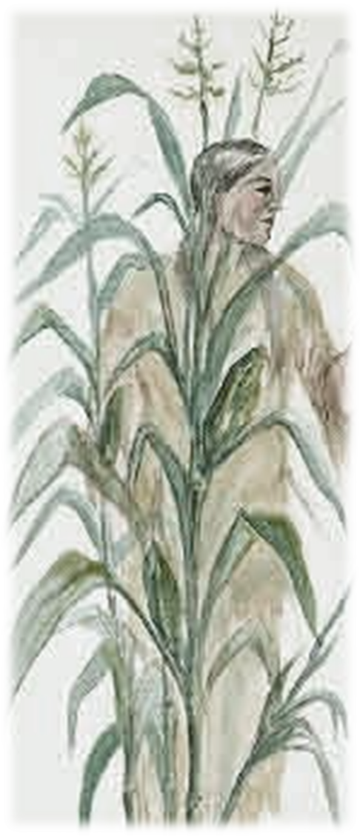
Her green shawl faded & grew thin & old. Her hair, once long & golden, was tangled by the wind. Day & night she sighed for her sisters to return to her, but they did not hear her. Her voice when she tried to call to them was low & plaintive like the wind.

Slide 14
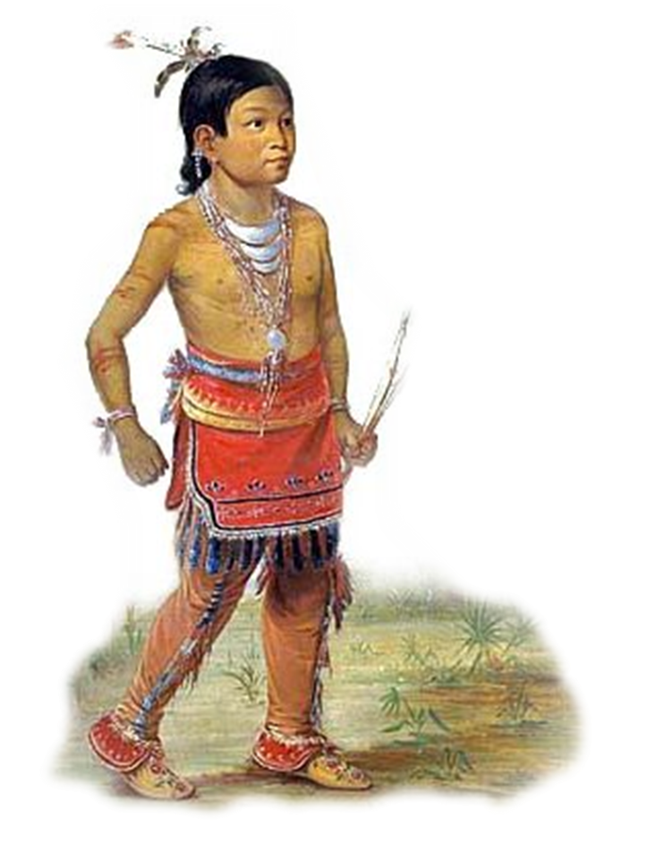
But one day when it was the season of the harvest the little Indian boy heard the crying of the third sister who had been left to mourn there in the field. He felt sorry for her, & he took her in his arms & carried her to the lodge of his father & mother.

Slide 15
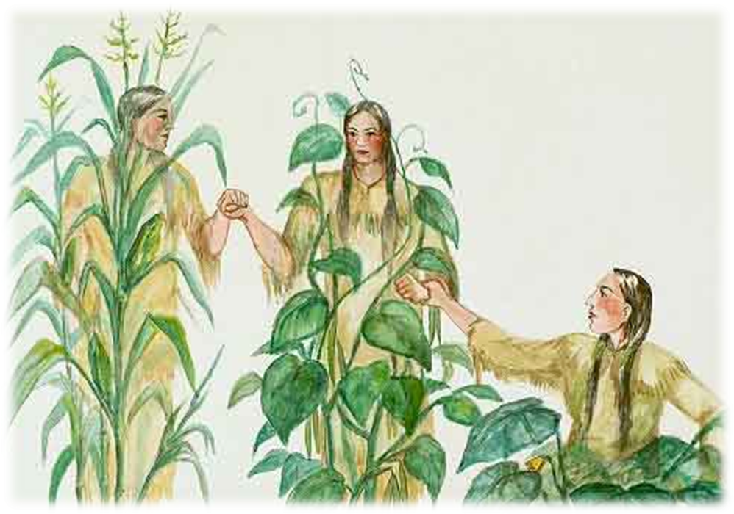
Oh what a surprise awaited her there! Her two lost sisters were there in the lodge of the little Indian boy, safe & very glad to see her.

Slide 16
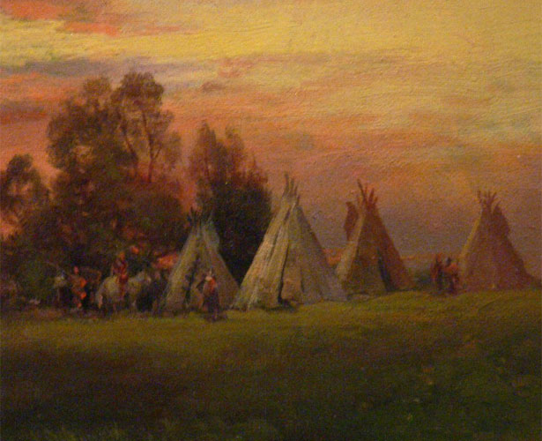
They had been curious about the Indian boy, and they had gone home with him to see how and where he lived. They had liked his warm cave so well that they had decided now that winter was coming on to stay with
him. And
they were
doing all
they could
to be useful.

Slide 17
The little sister in green, now quite grown up, was helping to keep the dinner pot full.

Slide 18
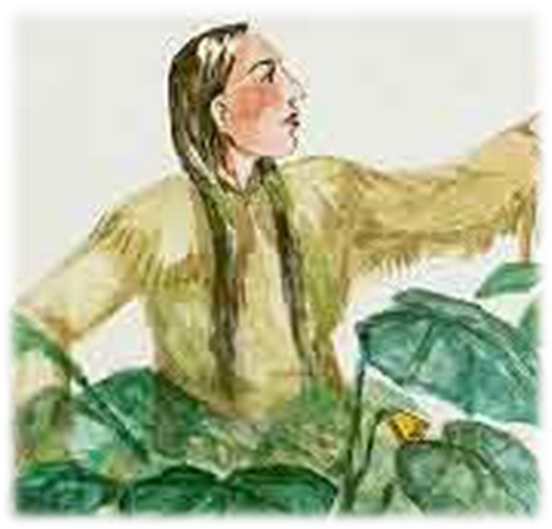
The sister in yellow sat on the shelf drying herself, for she planned to fill the dinner pot later.

Slide 19
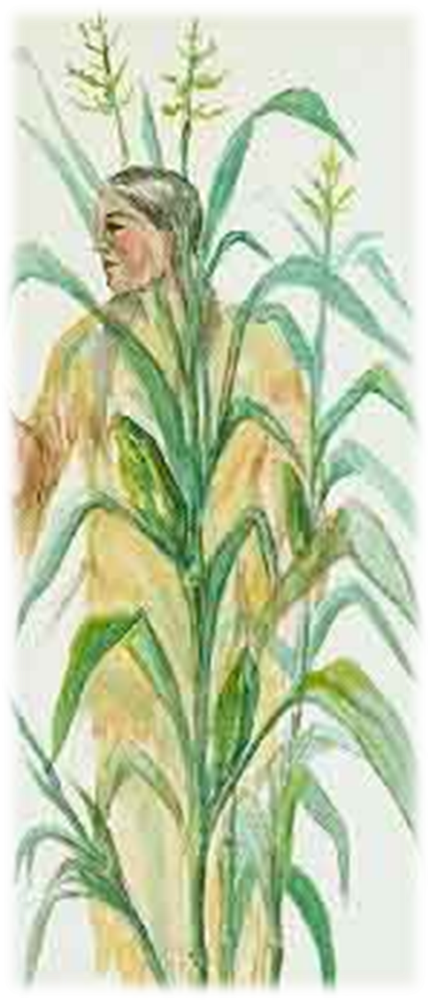
The third sister joined them, ready to grind meal for the Indian boy. And the three were never separated again.

Slide 20
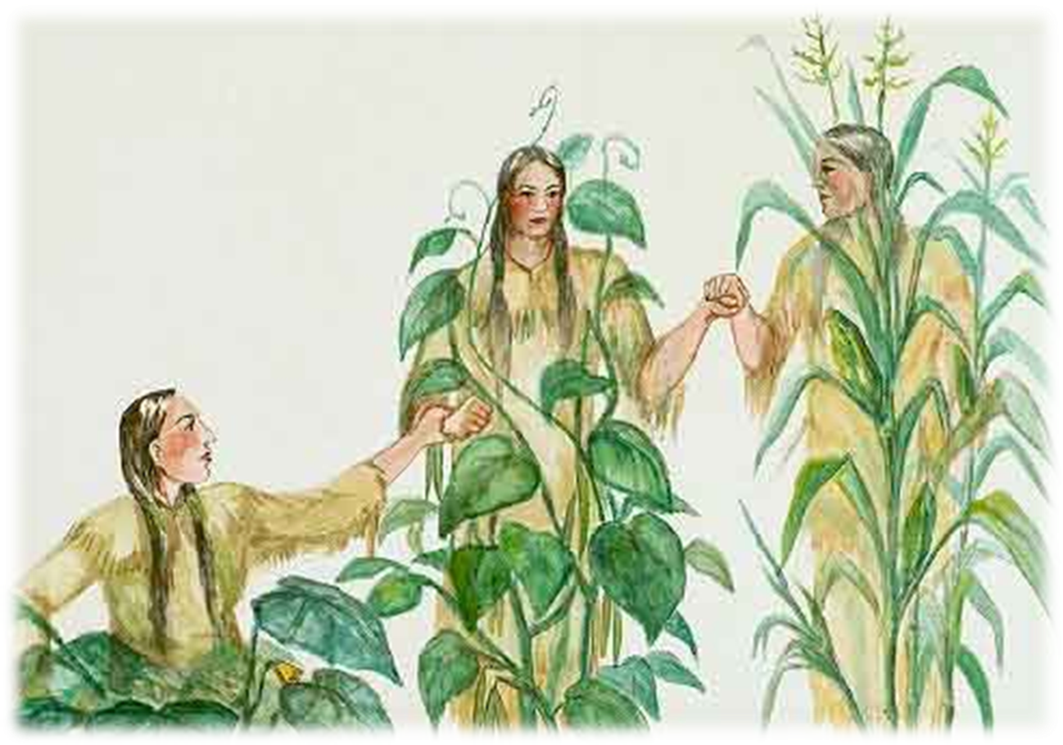
The End

Slide 21
Who are the Three Sisters?

Slide 22
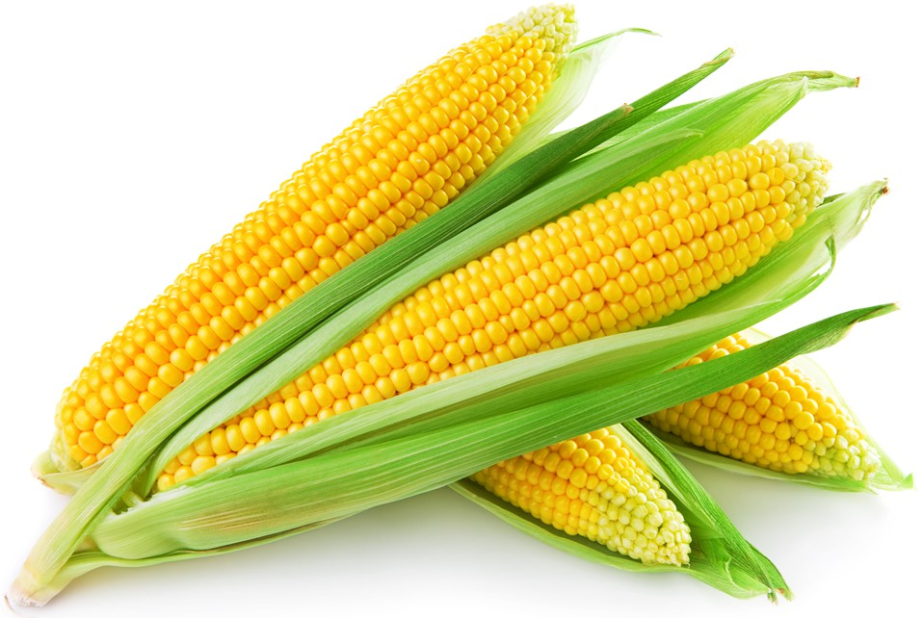
Corn
The eldest sister, standing straight and tall above the others trying to guard them.
She wore a pale green shawl, & had long, yellow hair that tossed about her head in the breezes

Slide 23
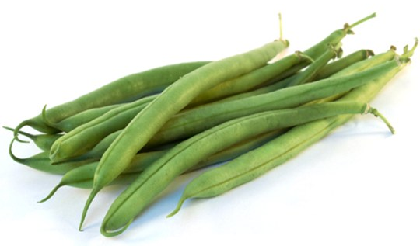
Beans
The little sister, so young that she could only crawl at first, & she was dressed in green.

Slide 24
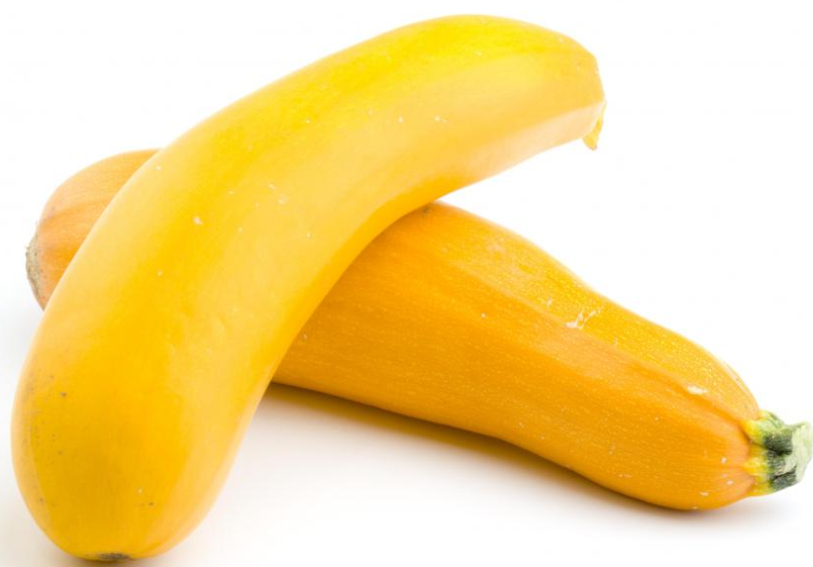
Squash
Wore bright yellow, and had a way of running off by herself when the sun shone and the soft wind blew in her face.

Slide 25
Creating a Three Sisters Garden

Slide 26
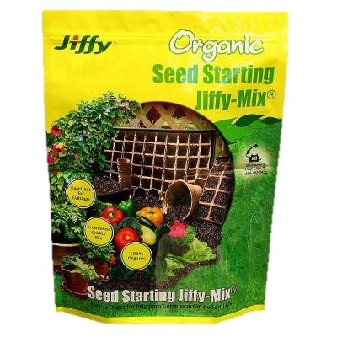
Corn
Get a pot
Write name on the outside of pot
Fill with soil
Collect a corn seed
Plant corn seed
After two weeks repot corn in a bigger pot or move outside

Slide 27
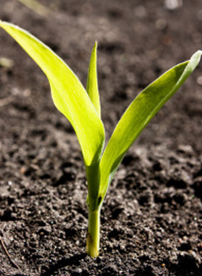
Beans & Squash
When repotting or moving corn outside it is time to plant the last two sisters
Plant bean seed on the right side of the corn plant
Plant squash seed on the left side of the corn plant
Water

Slide 28
Growing a Three Sisters Garden

Slide 29
Things Our Sisters Need
Follow planting instructions given earlier
Repot corn or move outside after two weeks
Plant beans and squash
Water
Sunlight
Room to grow
Time

Slide 30
Nutrition and the Three Sisters

Slide 31
Corn
For Sisters
For Us
Provides support for beans
Carbohydrates
Grain
Amino acids

Slide 32
Beans
For Sisters
For Us
Help supply nitrogen to plants, especially corn
Protein
Fiber
Two essential amino acids that corn lacks

Slide 33
Squash
For Sisters
For Us
Shade soil
Prevent weed growth
Deter animal pests
Vitamin A
Quality fats that corn and beans lack

Slide 34
Nutrition and the Three Sisters Conclusion
For Sisters
For Us
Help each other grow
Corn = support
Beans = nitrogen
Squash = protection
More colorful plates, balanced diets

Slide 35
The Next Step
Here are some recipes to try, after your garden is ready to harvest

Slide 36
Three Sisters Stew
Prep time: 30 – 40 minutes Serves: 6 – 8 people
Ingredients:
3 cups pinto or kidney beans
2 – 3 cloves of garlic, minced
2 teaspoons dried oregano
1 teaspoon cumin seeds
½ teaspoon cinnamon
1 tablespoon extra virgin olive oil
1 medium onion, chopped
1 ½ teaspoons sea salt
2 – 3 cups winter squash, cut in chunks
14 oz. can chopped tomatoes
1 tablespoon chile powder
1 ½ cups fresh or frozen corn
8 – 10 tablespoons grated cheese , as garnish
Steps:
In large pot, quickly dry-toast oregano, cumin seeds, and cinnamon
Add oil, onion, salt and garlic. Sauté until onions are soft.
Add squash, tomatoes, and chile powder and cook for 20 minutes, until squash is soft. Add some water if mixture seems dry.
Add cooked beans and corn; simmer until corn is tender. Season to taste.
Serve hot and enjoy!

Slide 37
Corn Bread
Prep time: 30 – 35 minutes Yields: 6 – 8 1, 9 x 13 pan
Ingredients:
3 eggs
1 ¼ cup milk
½ pound unsalted butter (2 sticks)
3 cups Bisquick
1 cup sugar
2 ½ tsp. baking power
¼ cup stone ground corn meal
Steps:
Wisk together eggs and milk with melted butter.
Combine dry ingredients and wisk in.
Bake at 350 for 30 – 35 minutes or until set and golden brown

