Slide 1
The Growing of a Seed
Corn Growth Cycle and Foldable Activity

Slide 2
From Seed to Flower
Intro Video (click on link below and watch how a seed grows)
http://wkar.pbslearningmedia.org/resource/tdc02.sci.life.colt.plantsgrow/from-seed-to-flower/
Discuss similarities and differences on plants and animals
Read poem on the next slides and talk about plant growth

Slide 3
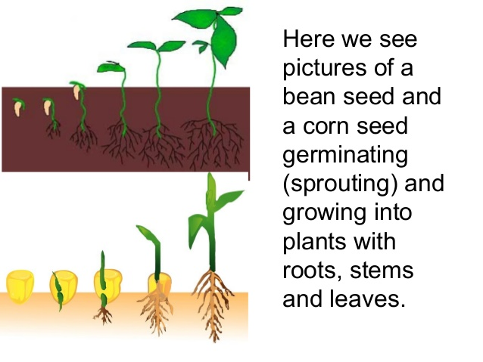

Slide 4
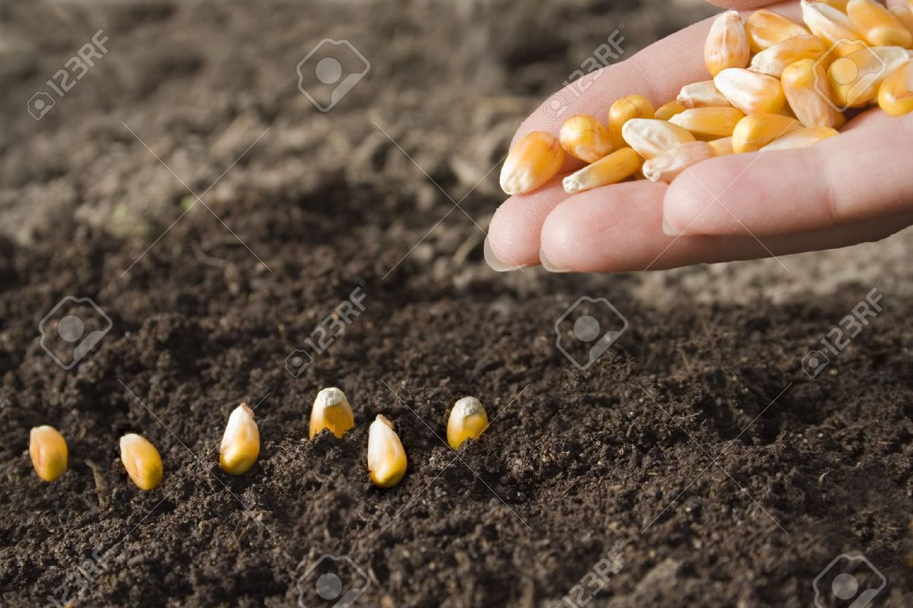
It starts with a seed,
Oh boy! Yes indeed!

Slide 5
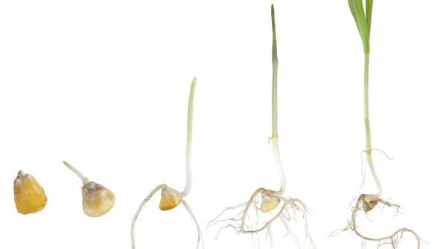
As the roots start to grow,
stand back; let her go.

Slide 6
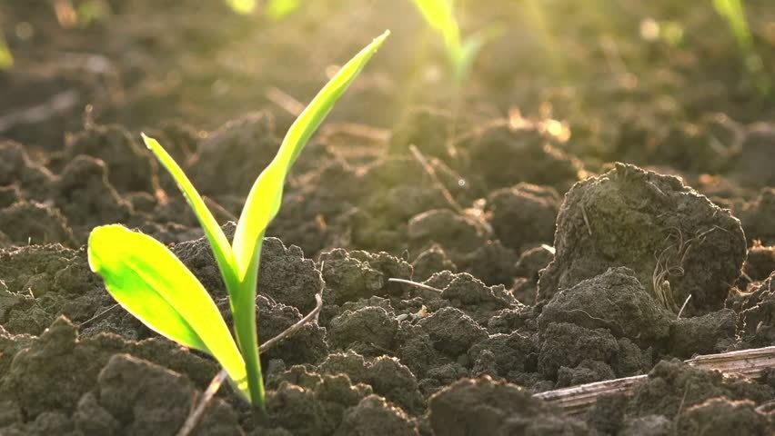
When the seed starts to
sprout, farmers dance,
scream and shout!

Slide 7
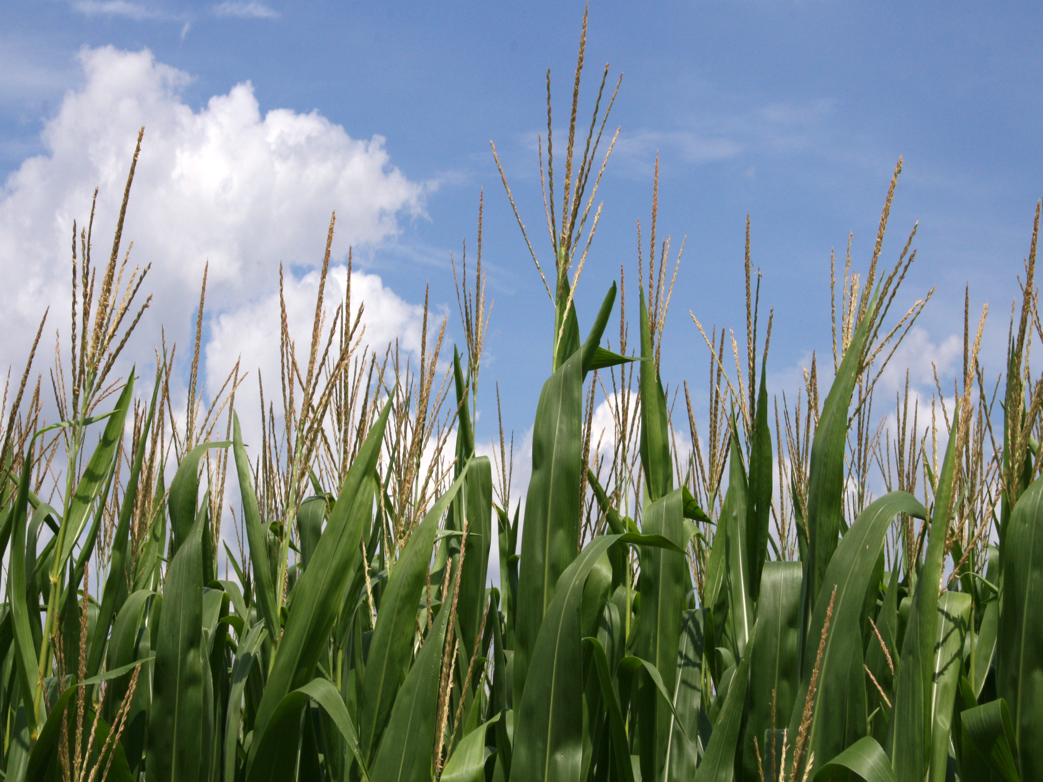
It’s bigger by the day
and the tassels start to stay

Slide 8
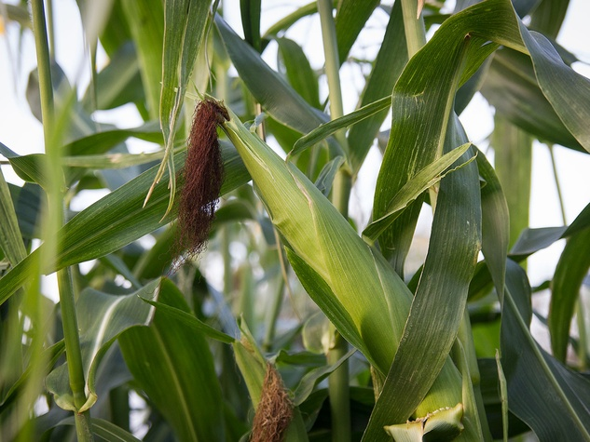
With harvest time near,
the ears will appear.

Slide 9
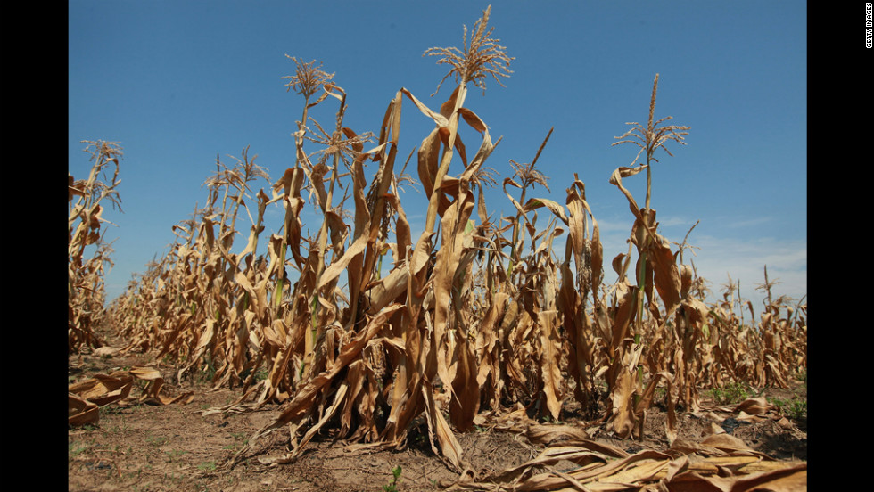
And when the leaves start crunching…

Slide 10
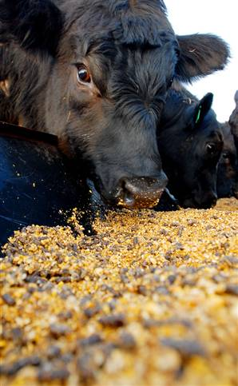
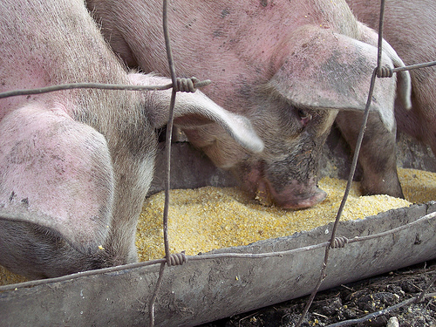
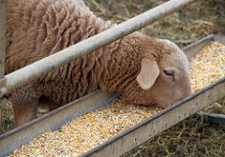
Soon, they’ll be munching!

Slide 11
Directions
As we go through the cycle, please draw what you see to help you remember how corn plants grow!

Slide 12
